Slide 1


Gateway & Naming Server

Slide 2
Gateway Server(API Gateway)
An API Gateway acts as a single entry point for a collection of microservices. Any external client cannot access the microservices directly but can access them only through the application gateway

Slide 3
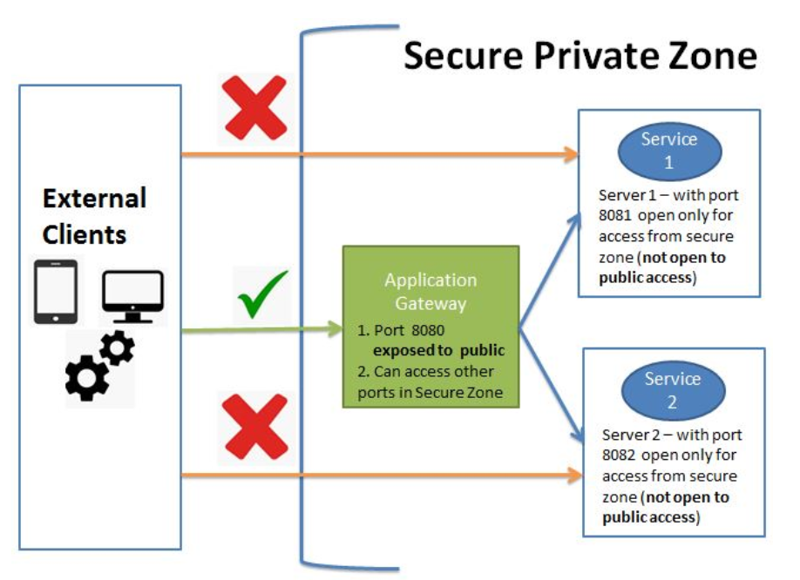

Slide 4
Advantages of API Gateway
This improves the security of the microservices as we limit the access of external calls to all our services.
The cross cutting concerns like authentication, monitoring/metrics, and resiliency will be needed to be implemented only in the API Gateway as all our calls will be routed through it.
The client does not know about the internal architecture of our microservices system. Client will not be able to determine the location of the microservice instances.
Simplifies client interaction as he will need to access only a single service for all the requirements.

Slide 5
Netflix Zuul
Adding in properties file
server.port=8080
#redirect
zuul.routes.lms-user-service.url=http://localhost:8092
zuul.routes.lms-leave-service.url=http://localhost:8091
zuul.sensitiveHeaders=Cookie,Set-Cookie
Dependency
<dependency>
<groupId>org.springframework.cloud</groupId>
<artifactId>spring-cloud-starter-netflix-zuul</artifactId>
</dependency>

Slide 6
Netflix Zuul & Spring Cloud Gateway
Zuul is a blocking API. A blocking gateway api makes use of as many threads as the number of incoming requests. So this approach is more resource intensive. If no threads are available to process incoming request then the request has to wait in queue.
Spring Cloud Gateway is a non blocking API. When using non blocking API, a thread is always available to process the incoming request. These request are then processed asynchronously in the background and once completed the response is returned. So no incoming request never gets blocked when using Spring Cloud Gateway

Slide 7
Spring Cloud Gateway
Spring Cloud Gateway is API Gateway implementation by Spring Cloud team on top of Spring reactive ecosystem. It consists of the following building blocks-Route: Route the basic building block of the gateway. It consists of
ID
destination URI
Collection of predicates and a collection of filters
A route is matched if aggregate predicate is true.
Predicate: This is similar to Java 8 Function Predicate. Using this functionality we can match HTTP request, such as headers , url, cookies or parameters.
Filter: These are instances Spring Framework GatewayFilter. Using this we can modify the request or response as per the requirement

Slide 8
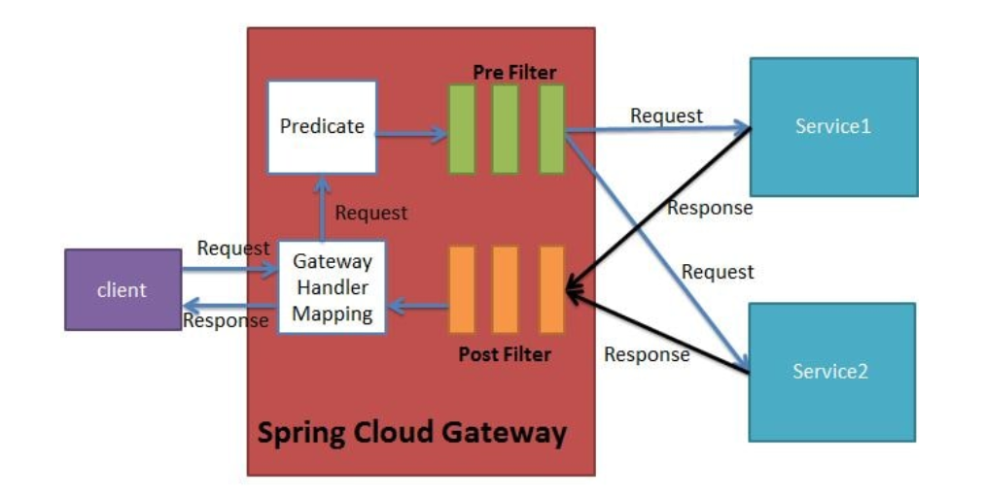
When the client makes a request to the Spring Cloud Gateway, the Gateway Handler Mapping first checks if the request matches a route. This matching is done using the predicates. If it matches the predicate then the request is sent to the filters

Slide 9
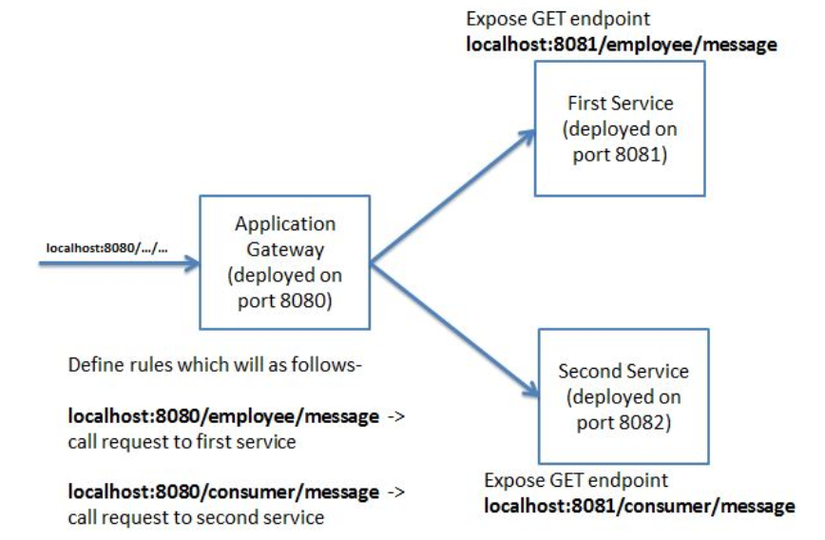

Slide 10
Spring Cloud Gateway Implementation
<properties>
<java.version>1.8</java.version>
<spring-cloud.version>Greenwich.SR2</spring-cloud.version>
</properties>
<dependency>
<groupId>org.springframework.cloud</groupId>
<artifactId>spring-cloud-starter-gateway</artifactId>
</dependency>
<dependency>
<groupId>org.springframework.cloud</groupId>
<artifactId>spring-cloud-dependencies</artifactId>
<version>${spring-cloud.version}</version>
<scope>import</scope>
</dependency>

Slide 11
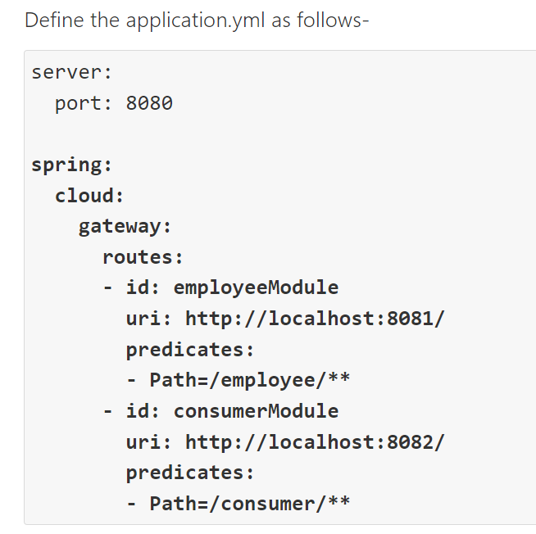
Spring Cloud Gateway Implementation
1St Way Define in yml file

Slide 12
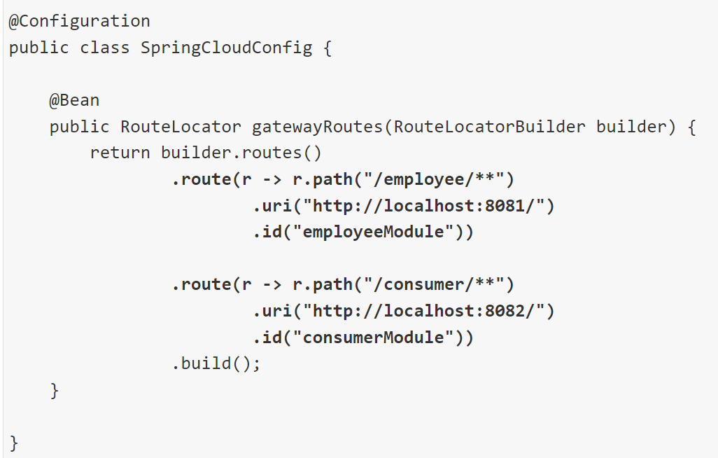
Spring Cloud Gateway Implementation
2nd Way create own configuration file

Slide 13
Naming Server
The naming server is a computer application that implements a network service for responding to queries against a directory service.
Eureka naming server is an application that holds information about all client service applications. Each microservice registers itself with the Eureka naming server.
The naming server registers the client services with their port numbers and IP addresses. It is also known as Discovery Server.

